Slide 1


The Mzamomtsha Primary School Project
By Tech Loyalties

Slide 2
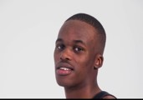
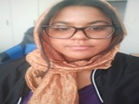
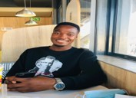
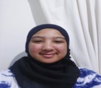
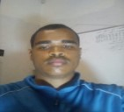
Meet our team
Hlombe Malandela
Zainap Van Blerck
Lwazi Mdukulwana
Yusrah Safedien
Ryan Goosen

Slide 3
Mzamomtsha Primary School Background
Between Khayelitsha and Mfuleni in Driftsand.
Teaches Grades 1 – 12.
Has a Facebook and Twitter account.

Slide 4
Problem
Mzamomtsha lacks an online presence.
SO WHAT?
Mzamomtsha is an underprivileged, overpopulated school in an undeveloped community.
Lack of exposure = Lack of funding

Slide 5
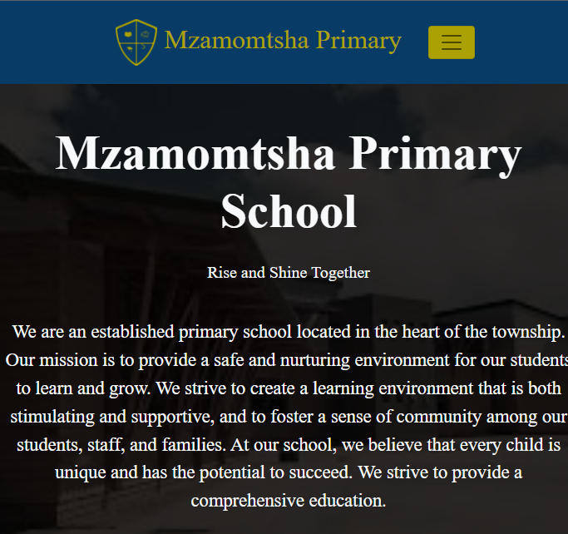
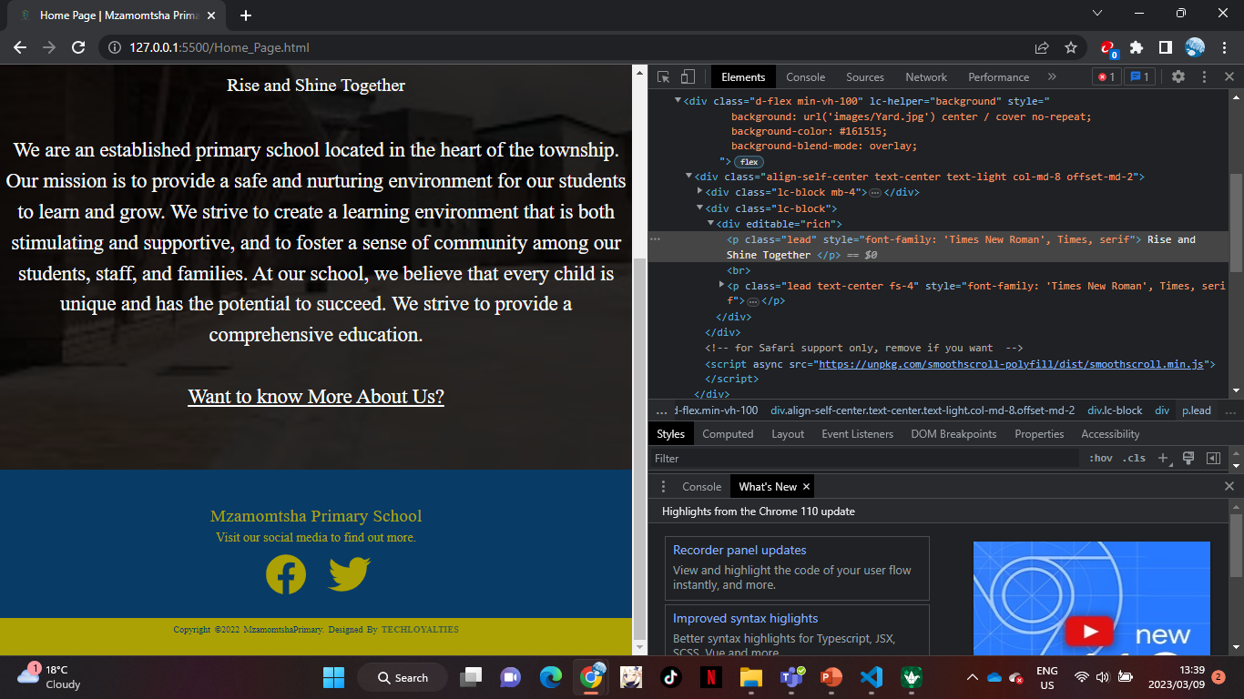
The Solution
A website promoting Mzamomtsha Primary School.
Let’s users know:
What Mzamomtsha Primary School stands for.
What events the school hosts.
How to contact the school.

Slide 6
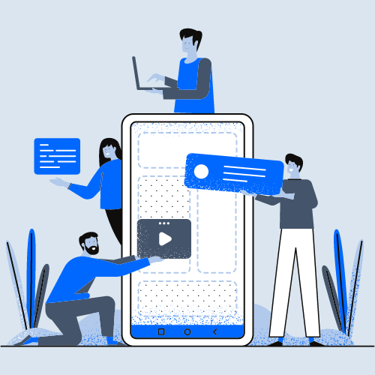






The Stakeholders
Tech Loyalties
Mzamomtsha Staff
Website Users
Sponsors
Students & Parents
Government
Large Stake
Lesser Stake

Slide 7
Project Plan
Preparing website for launch.
Week 1
Research on Mzamomtsha Primary School.
Week 2
Wireframe design
Week 3
User Interface CSS design – Styling the website.
Week 4
Week 5: Launch Week
Stakeholder requirements.
Project Plan design: https://app.teamgantt.com/projects/gantt?ids=3379059
Content placement.
Planning the code structure.
Putting the website together.
Code testing.
Debugging – fixing errors.
Mock presentation.
Preparing presentation.
Present.
Audience Research.

Slide 8
Risk Analysis
RISKS | MITIGATION
Long loading period. | Server evaluation; aesthetically pleasing loading page.
Different screen sizes. | Automated built in functionality to adjust according to screen.
Long-term website management. | Hiring external website developers or training a staff.
User’s understanding of the websites functions. | UI will be tested and have responsive designs.
Website platform complex repairs or updates. | Website will be designed to allow independence between pages.

Slide 9
Risk Analysis
Long Loading Periods
Server hosting evaluation for best compatibility.
Element Adjustment to Screen Size
Implemented responsiveness – Bootstrap 5 & Flexboxes.
Users Understanding of the Website
Familiar generic tools and clear labels.

Slide 10

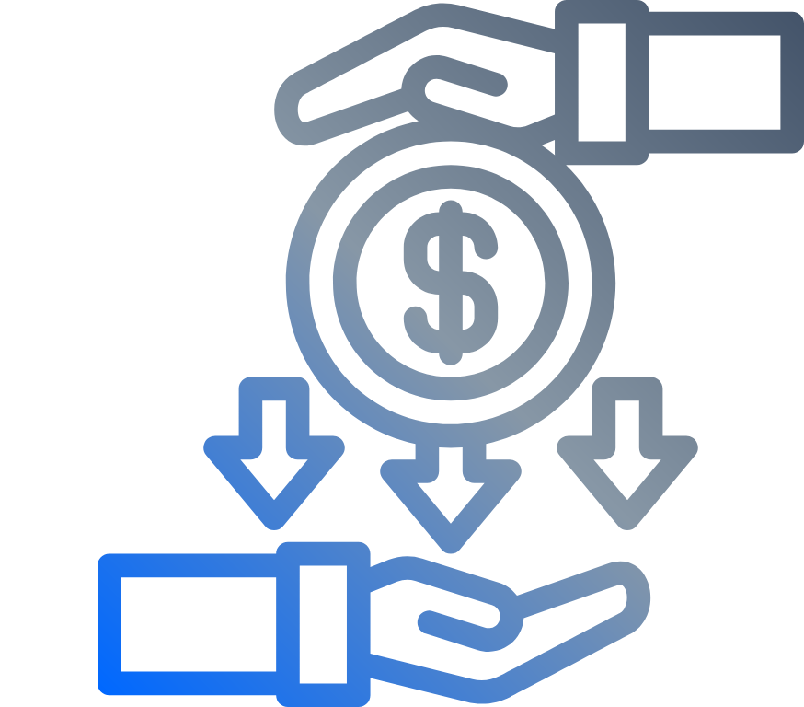

Goals
Increase Online Exposure
Increased Resource Assistance
Better Education Environment

Slide 11
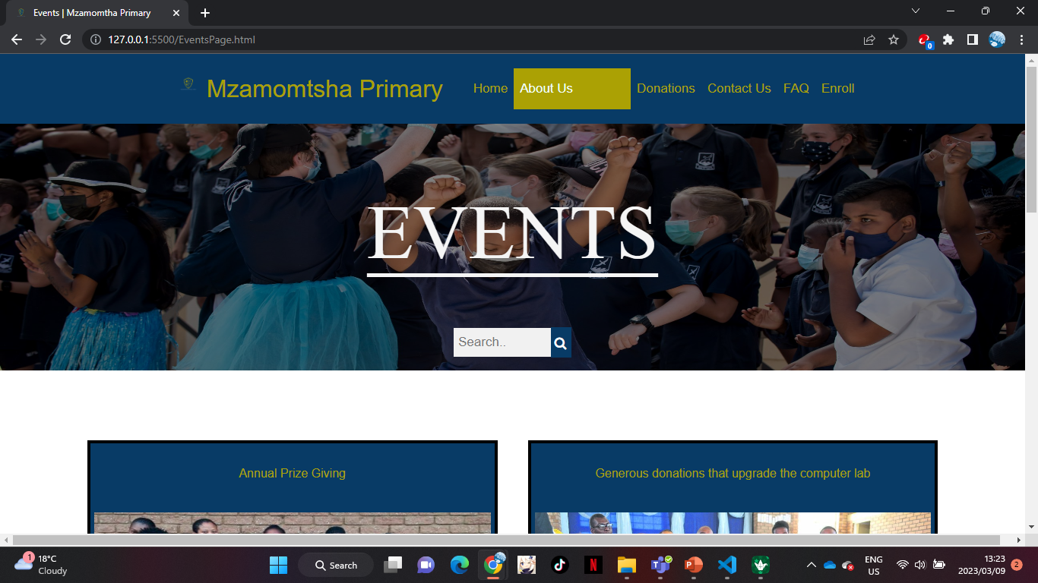
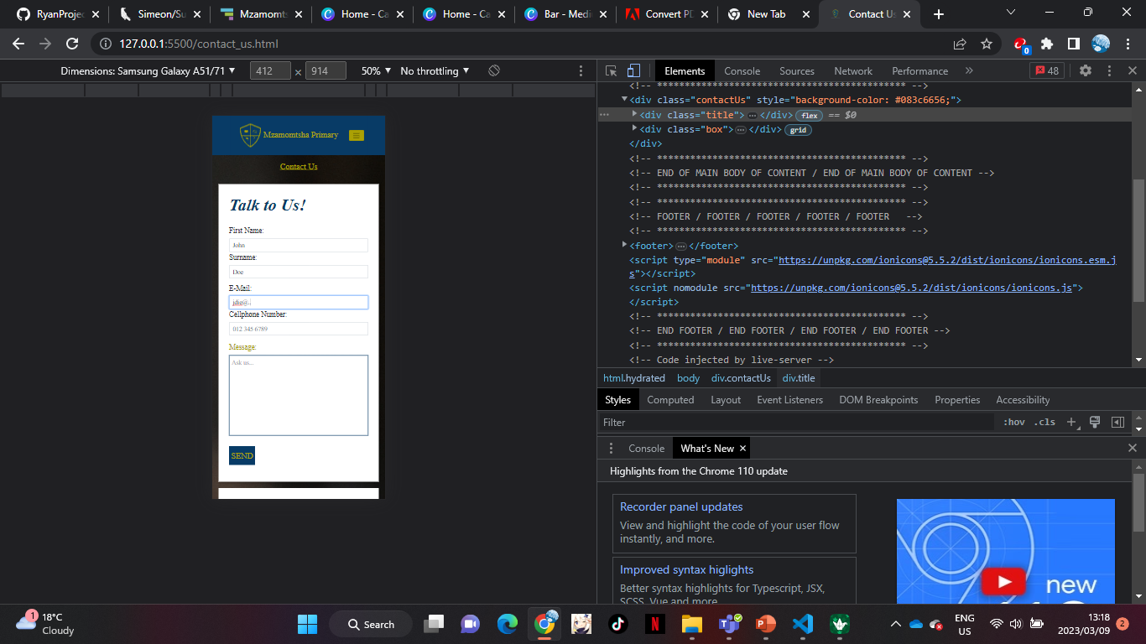
Final Product
https://sprightly-sunflower-999cff.netlify.app

Slide 12
Thank You
Any Questions?

